Slide 1

Loan approval prediction
Khushi Jamloki – 2210990513 Diya Raina– 2210990304 Keshav Goel - 2210990513

Slide 2

INDEX
Introduction
Problem Statement
Key features
Data Analysis
Result
References
Conclusion

Slide 3

Introduction
1. Small loans catalyze economic growth by fueling entrepreneurial endeavors and fostering innovation.
2. They serve as crucial instruments for social mobility, enabling access to education and opportunity for individuals regardless of their financial background.
3. Mitigating default risk through effective risk assessment mechanisms is essential to maintain financial stability for both lenders and borrowers.
4. Leveraging AI in loan approvals reduces bias and processing time, enhancing accuracy in evaluating borrower eligibility.

Slide 4
Problem Statement
Data Acquisition and Preprocessing: Loan Approval Dataset
Problem Statement :
1. Implement machine learning and data mining techniques to predict loan approval probability, enhancing accuracy and reducing fraud risk for banks, housing finance companies, and NBFCs across various loan types and geographic locations.
2. Automate the loan eligibility assessment process by analyzing customer data such as demographic details, income, credit history, and loan amount, enabling efficient identification of eligible customers and optimizing resource allocation for financial institutions.

Slide 5
Key features
1. Implemented across various financial institutions' loan processing systems and online lending platforms to enhance decision-making accuracy and efficiency.
2. Integrated seamlessly into the loan approval workflows of banks, credit unions, and online lenders, ensuring compliance with regulatory standards and optimizing risk assessment processes.
3. Incorporated within banking systems, regulatory oversight platforms, and academic research environments to continuously refine and optimize loan approval prediction algorithms, driving improvements in lending practices and risk management strategies.

Slide 6
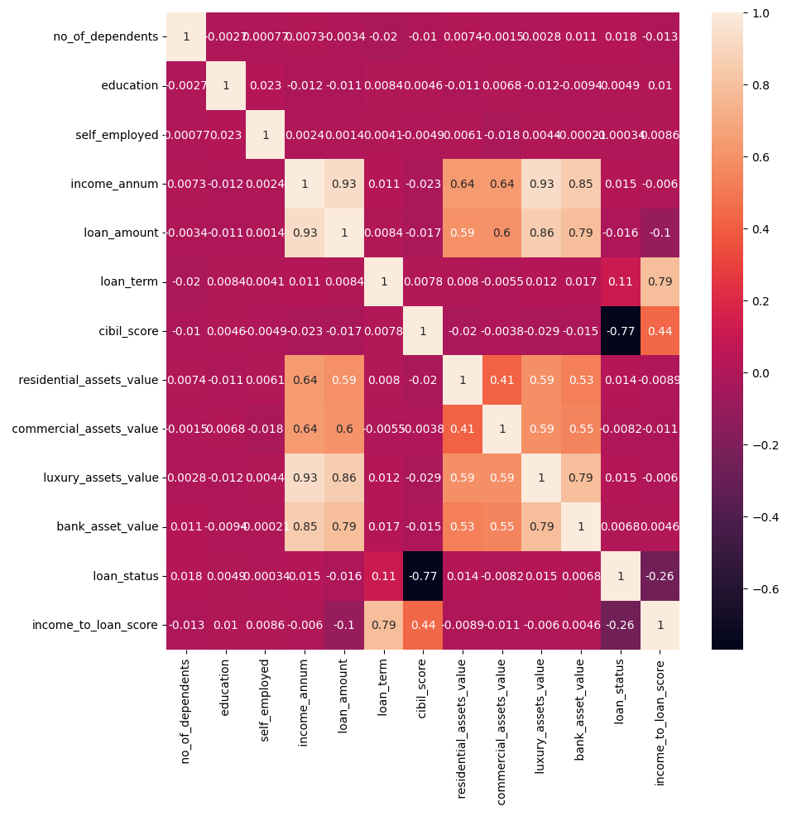
Data analysis
Visualizes the correlation between various financial and personal attributes

Slide 7
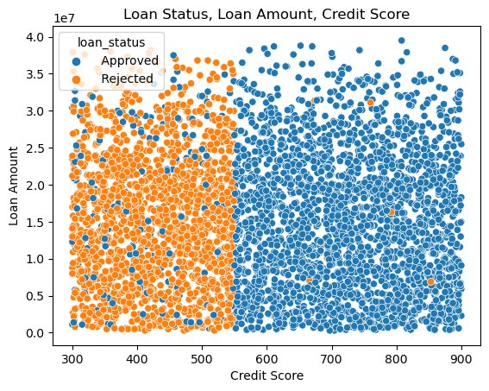
DATA ANALYSIS
The visualization suggests a correlation between higher credit scores and loan approval rates.
Applicants with higher CIBIL scores, indicating a history of responsible credit management and lower risk, are more likely to have their loan applications approved, while lower scores may lead to increased scrutiny or outright rejection due to perceived repayment risk.

Slide 8
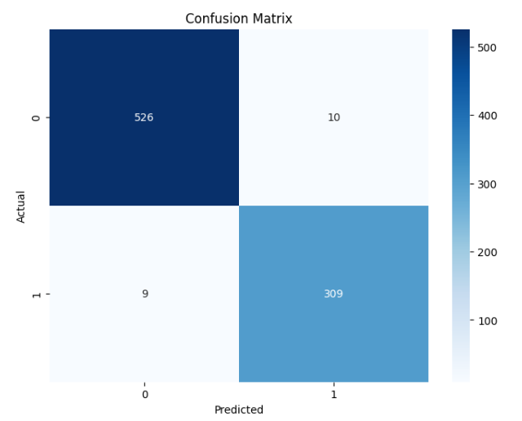
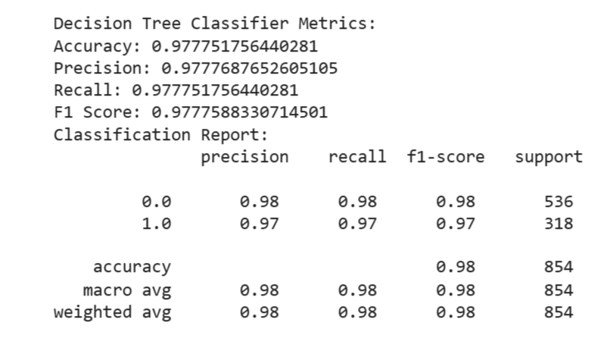
results
DECISION TREE MODEL RESULTS

Slide 9
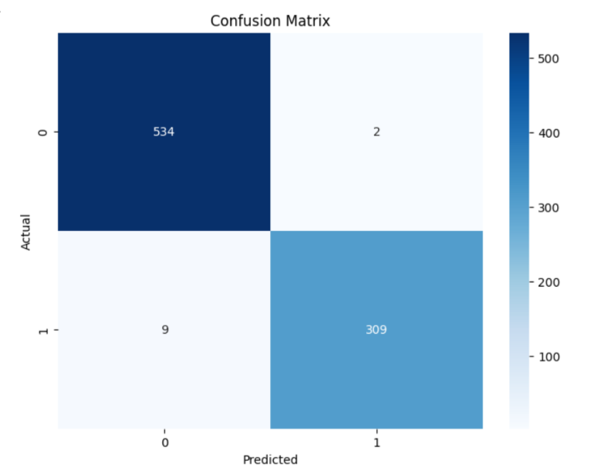
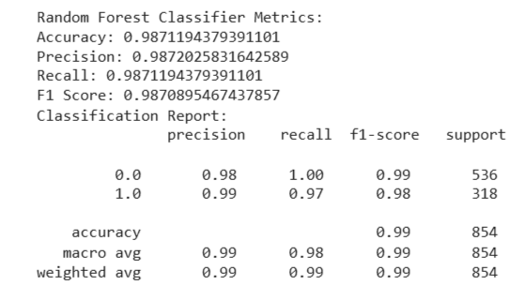
results
RANDOM FOREST MODEL RESULTS

Slide 10
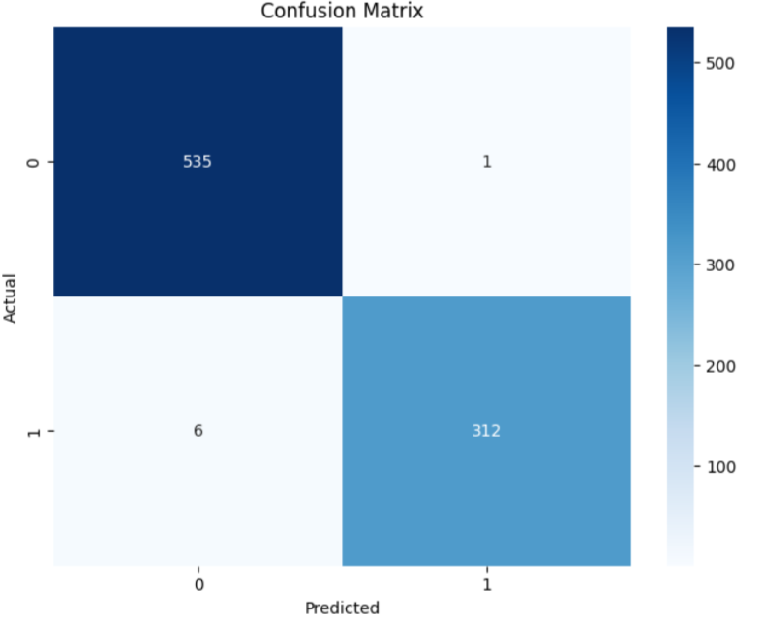
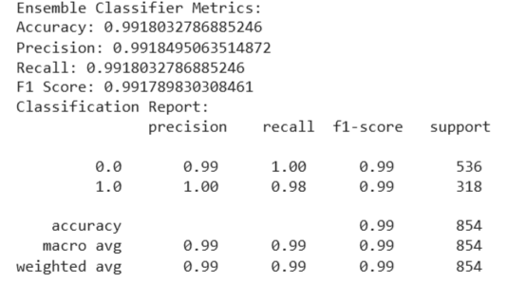
RESULTS
ENSEMBLE LEARNING RESULT

Slide 11
REFRENCES
Loan-Approval-Prediction-Dataset (kaggle.com)
Machine Learning Tutorial (geeksforgeeks.org)
Machine Learning Tutorial (tutorialspoint.com)
Loan Information
Cibil Score Information

Slide 12
CONCLUSION
Strong correlation between loan amount and annual income underscores the significance of financial capacity in loan approval decisions.
2.Shorter loan terms show higher approval rates, indicating lower perceived risk by lenders for these borrowers.
3.Luxury asset values and bank assets correlate positively with income, suggesting higher-income individuals possess such assets more frequently.
4.Categorical variables showed minor effects on loan amount, emphasizing the primary focus on financial indicators in approval decisions.
5.Machine learning models like Light GBM demonstrate high accuracy, highlighting their potential to enhance loan approval processes and mitigate default risks

Slide 13
Thank YOU!

